Slide 1
Scoops Inc. Inventory Summary Shaghayegh Haghbin

Slide 2
Scoops Inc. Total Revenues and Costs by Year
For the years 2021 through 2023, the total revenue was $800,000 and total costs were found to be $250,000.
The revenue total is higher than the costs total, therefore Scoops Inc. was profitable over the three- year period

Slide 3
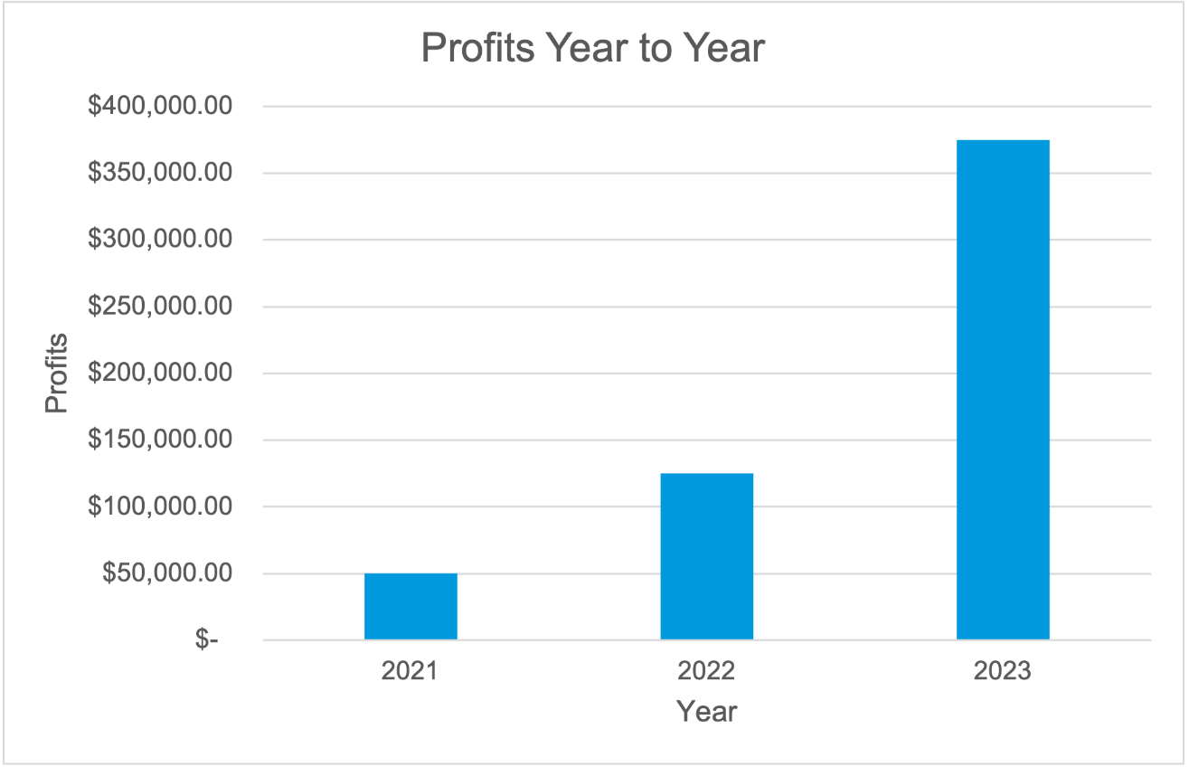
Scoops Inc. Profitability by Year
Scoops Inc. was profitable each year from 2021-2023
Profits increased each year as well

Slide 4
Summary
Scoops Inc. has had net profits in each of the 2021 - 2023 years.
Profitability has risen over the period.
Break even point would not be reached until a $375,000 drop in revenue.
Shipping costs are also significant at $0.10 per unit. We could lower commission costs by changing from a commission to a flat salary based on the latest year's data.

Slide 5
Thank you

